Slide 1

Moggy’s new medicine
What are inhalers?

Slide 2
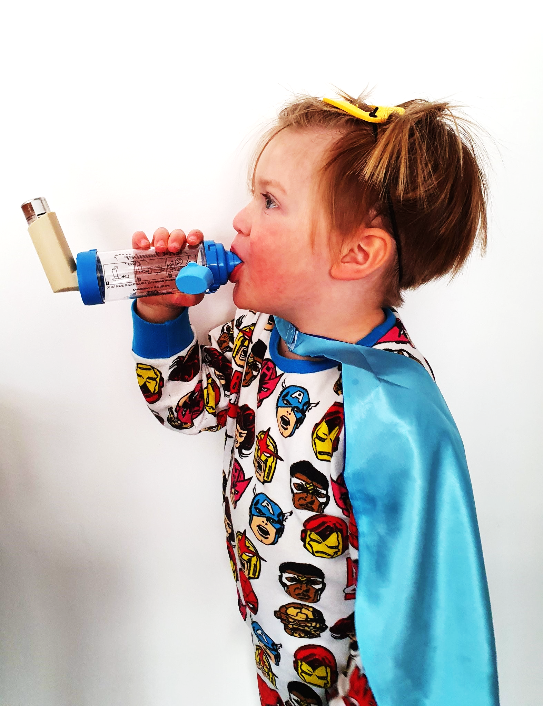
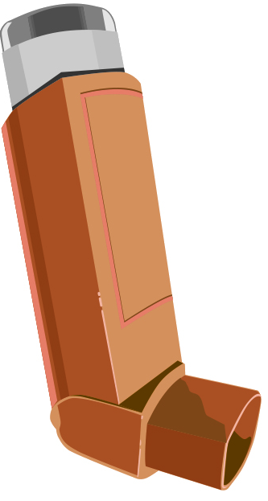
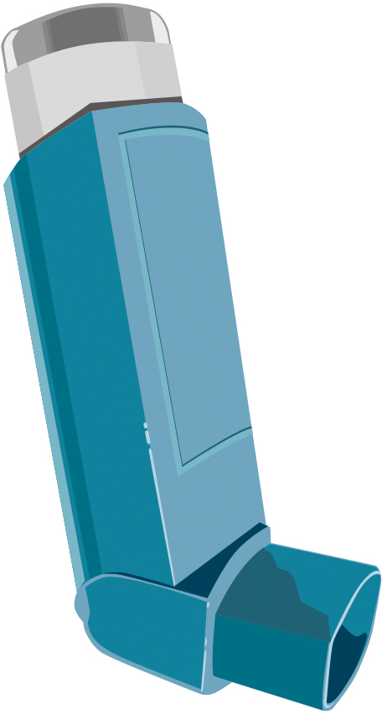
Moggy’s new medicine
Inhalers help people breathe in medicine that helps with asthma
Notes:
Notes for teacher:
There are two kinds of inhaler.
One is called a preventer
One is called a reliever
Inhalers can be different shapes and different colours
Inhalers are also sometimes called puffers.

Slide 3
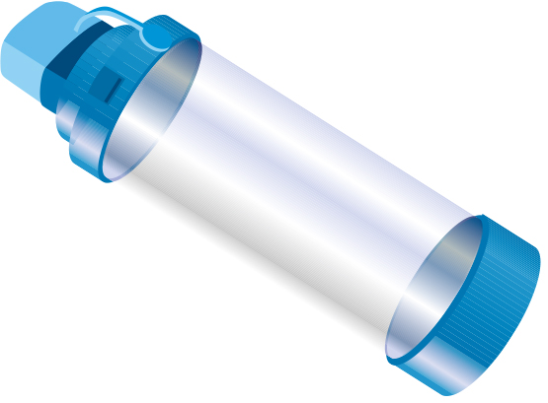
Moggy’s new medicine
Preventer
Reliever
Spacer
Notes:
Inhalers help people breathe in medicine that can help with asthma
Relievers
Reliever inhalers are usually blue.
These are taken when your asthma feels bad and/or you have symptoms like a tight chest or cough. The medicine makes it easier to breathe
People who have asthma should keep their blue inhalers with them or near them all of the time
Preventers
Preventer inhalers can be different colours, but they are usually brown (sometimes purple or orange)
People with asthma take the medicine in these every day, even if they feel ok. Moggy uses his twice a day. This is because it helps to stop breathing problems and keep lungs healthy and asthma under control
Spacers
A spacer is often used by children along with their inhalers because it helps to use an inhaler properly
A spacer is a plastic tube which attaches to an inhaler and helps to get the medicine right into the airways in your lungs. Moggy uses one of these to help breathe in the medicine from his inhalers.

Slide 4
Moggy’s new medicine
It is REALLY IMPORTANT that people with asthma use their inhalers properly
Notes:
Children with asthma should know about their own asthma and how to use their inhalers properly. Having something called an asthma plan can help other people (such as teachers) know what this is too.

